Slide 1




Screening of cWnt downstream targets involved in regulation of Dynamena pumilla body axis using differential expression analysis
Student:
Bredov Denis
Supervisor:
Stanislav Kremnyov, Department of Embryology, Lomonosov Moscow State University
GitHub

Slide 2
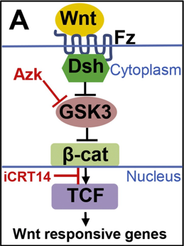
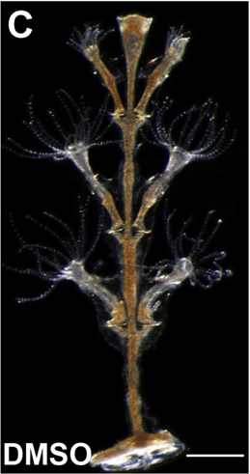
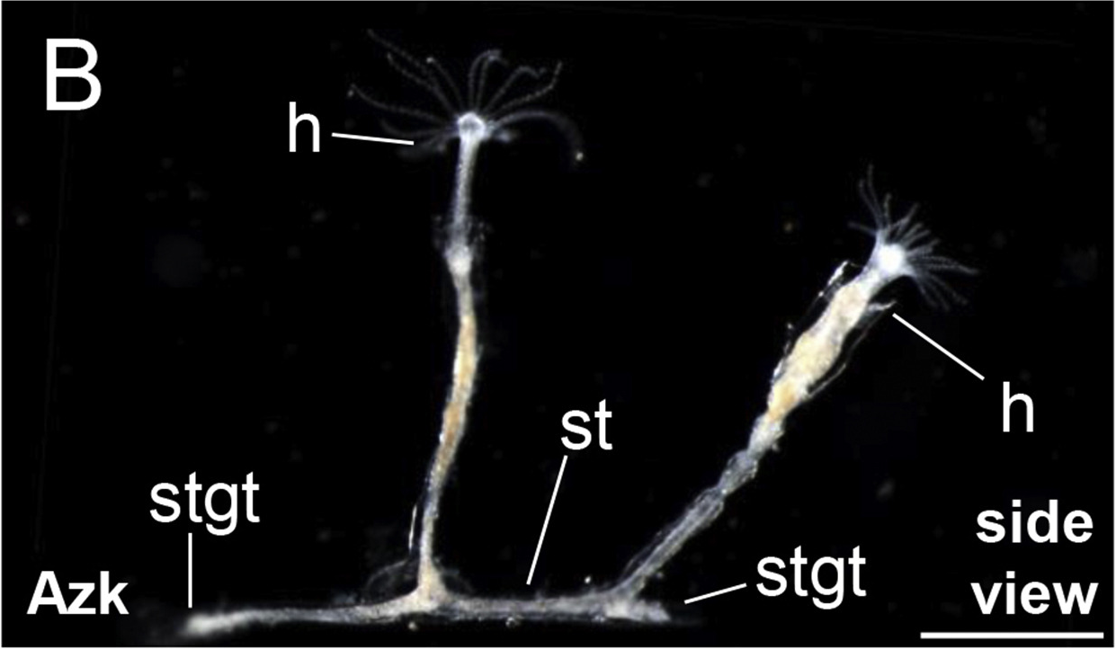
Aim and objectives
Aim :
Identify the entire spectrum of genes that could potentially regulate the morphological polarization of Dynamena pumila embryo under cWnt signaling pathway.
Objectives:
Perform differential expression analysis on untreated and experimental groups.
Identify transcripts with significant changes in expression.
Identify 100 transcripts with most remarkable upregulation and 100 transcripts with most remarkable downregulation in expression.
Reveal changes in expression for set of specific canonical Wnt signaling pathway effectors.
Bagaeva et al., 2019

Slide 3
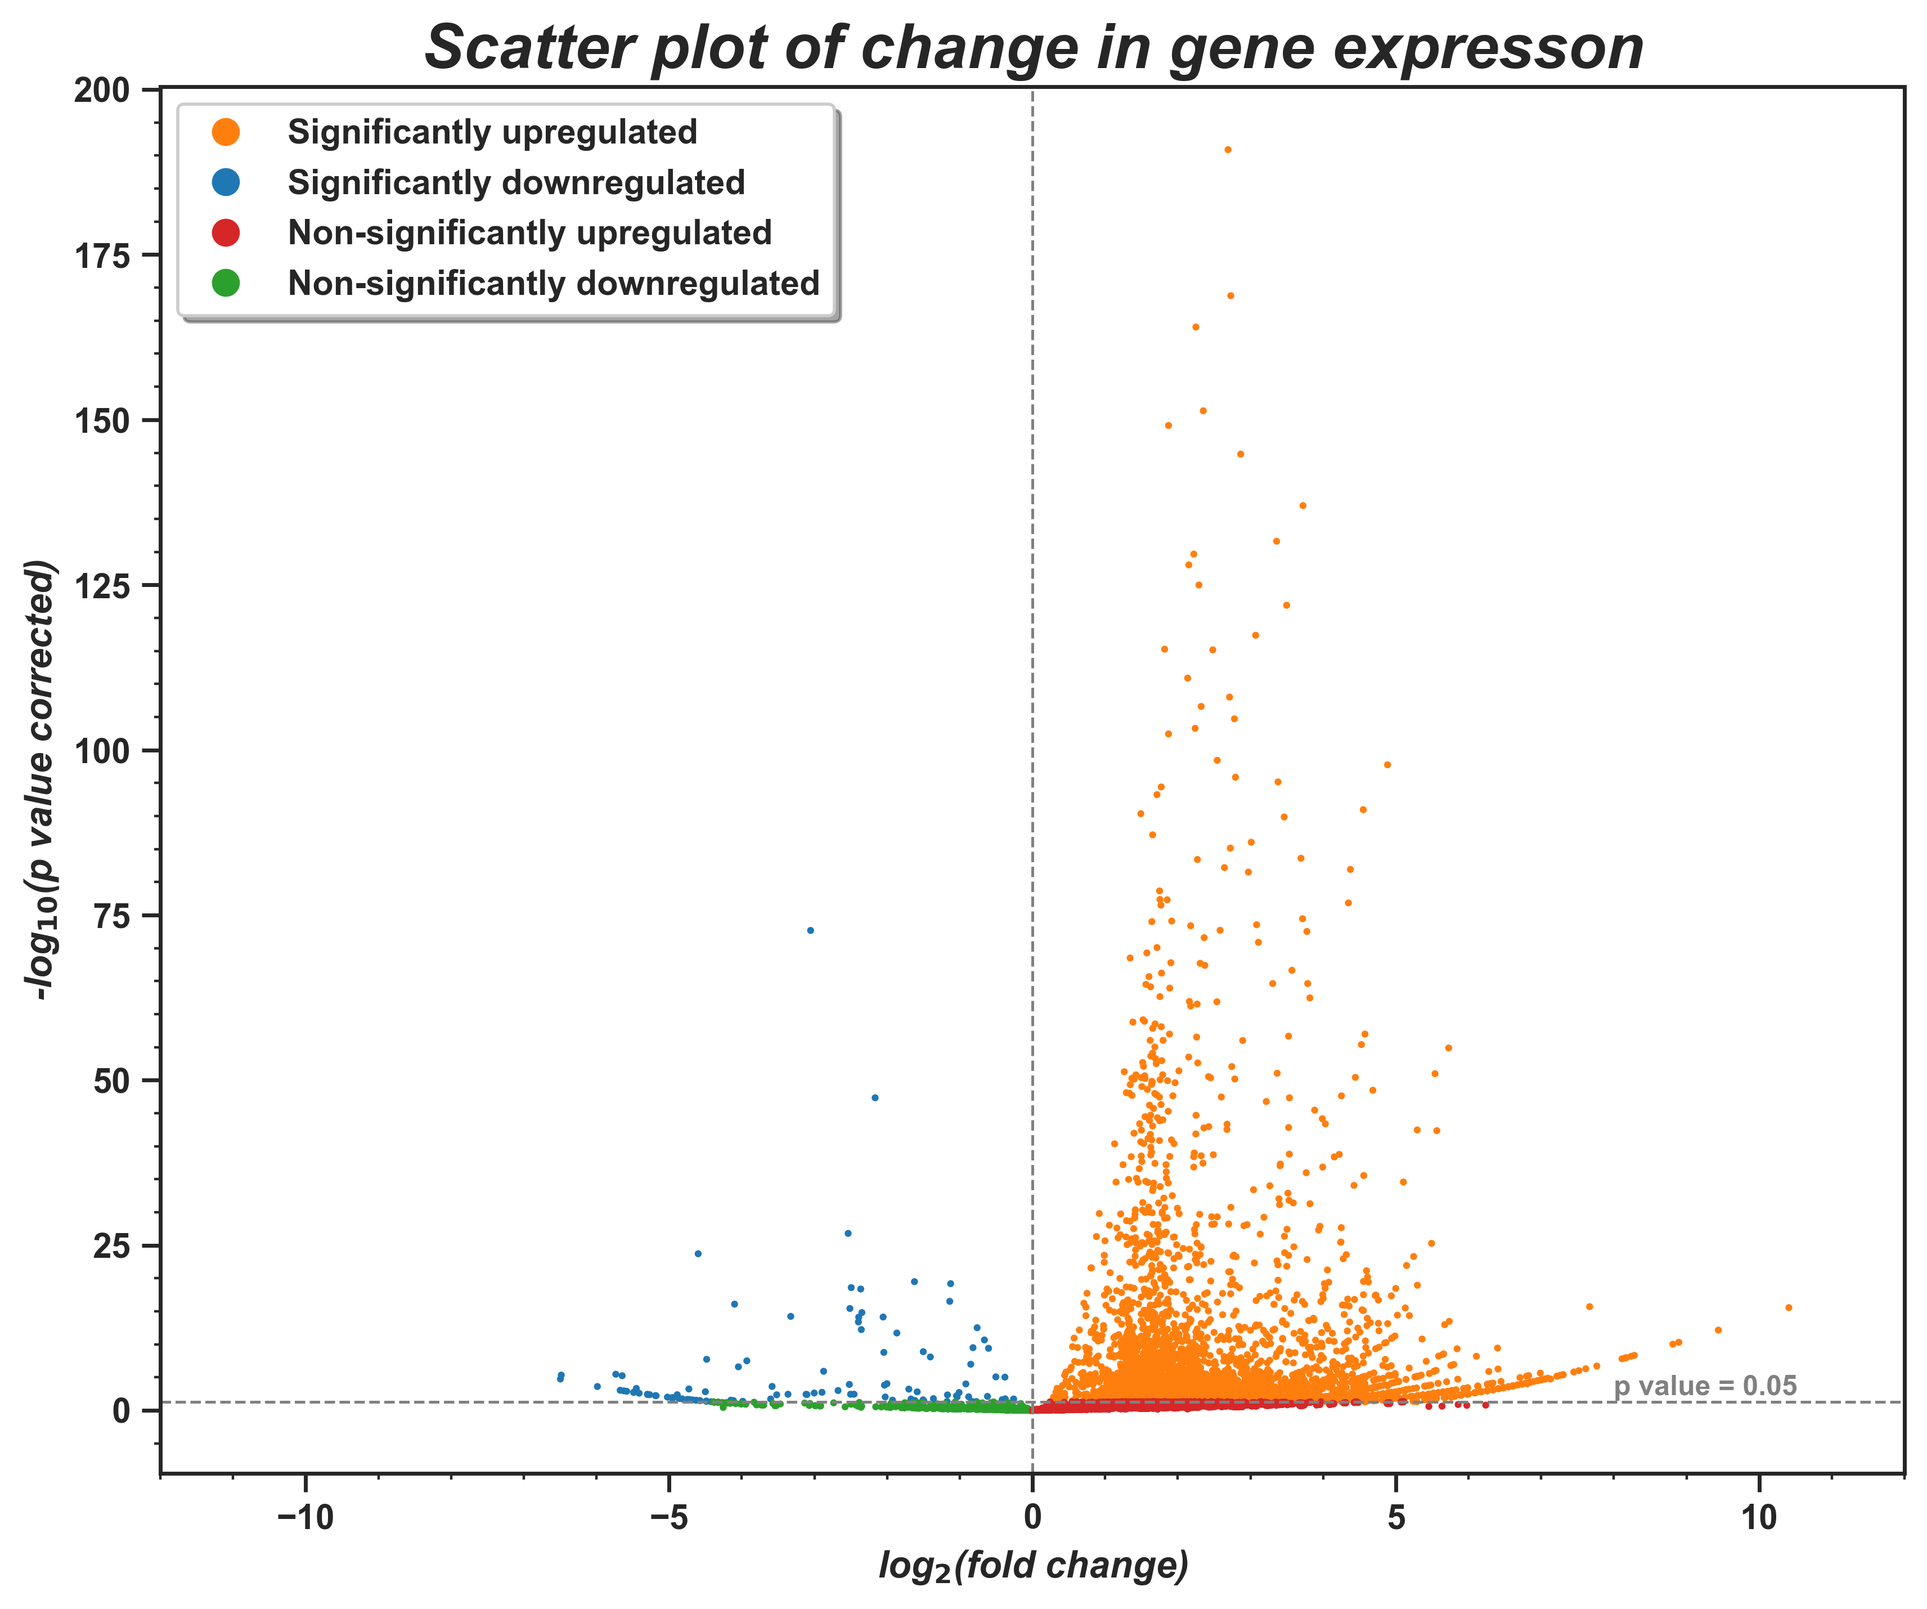
Identify transcripts with significant changes in expression
We identified 123445 differentially expressed transcripts, 5196 (4.2%) of them show significant change in expression (i.e. adjusted p-value was lesser than 0.05).
An upregulation in expression was observed for most transcripts (orange and red dots) while little part showed downregulation in expression (blue and green dots).

Slide 4
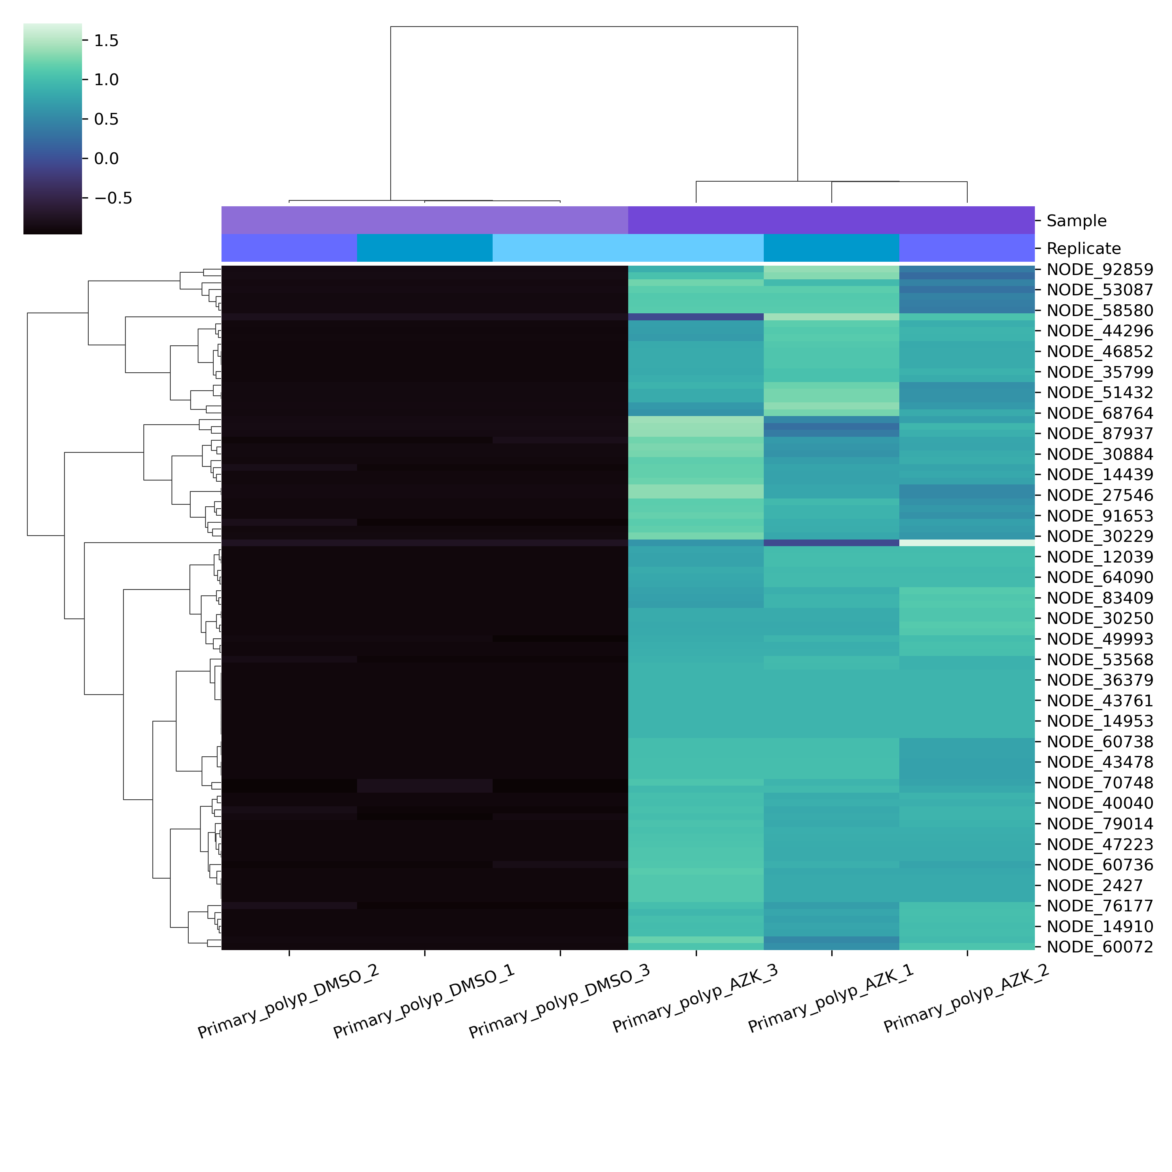
Identify 100 transcripts with most remarkable upregulation in expression
Top-100 transcripts with downregulation in expression predominantly corresponded to genes of different types of collagens (5 transcripts in total)
They also include members of Notch signaling pathway (4 transcripts in total)

Slide 5
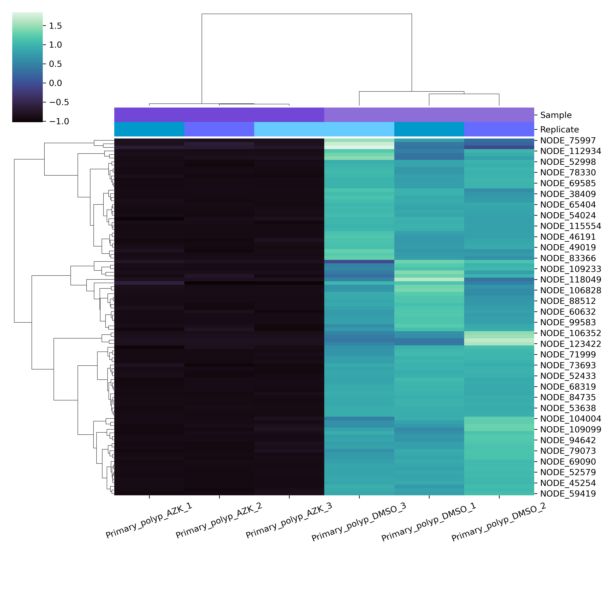
Identify 100 transcripts with most remarkable downregulation in expression
Among the top-100 transcripts with upregulation in expression, we identified members of cWnt pathway (8 transcripts in total).

Slide 6
Project repository
Code, workflow details and processed data available in project repository:
https://github.com/angrygeese/DynamenaProject_BI2023-24/tree/main

